Slide 1
Single Precision Floating point Multiplication
By :
Akhila Veedula
SaiNikhil Reddy Lokasani
Sai Samhitha Gaddam
Venkatesh Mukkapati

Slide 2
AGENDA :
Introduction to Floating Point.
Block Diagram of FPU
Flow chart and Rounding
Test Plan
System Verilog Constructs used
Challenges Faced and Edification
Future Scope
Reference

Slide 3
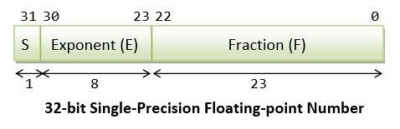
Introduction to Floating Point
Floating point numbers are a way to represent real numbers in a computer using a fixed number of bits.
A floating point number consists of three parts:
mantissa or significand or Fraction
Exponent
Sign
We represent these floating point numbers in IEEE 754 format. It defines the formats and rules for representing and manipulating floating-point numbers in computers.

Slide 4
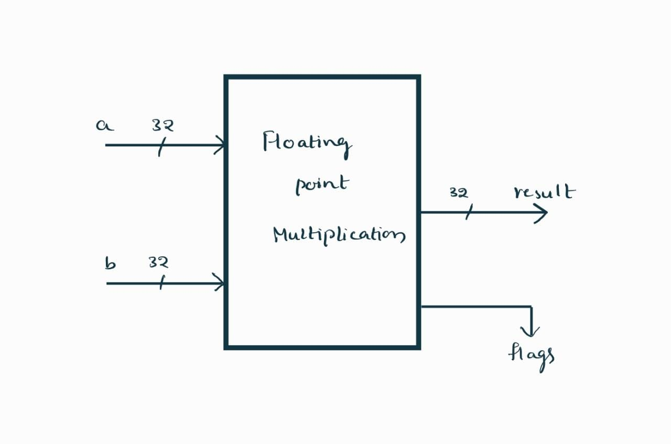
Block Diagram of FPU :

Slide 5
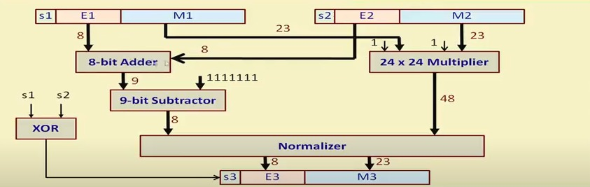
Flowchart :

Slide 6
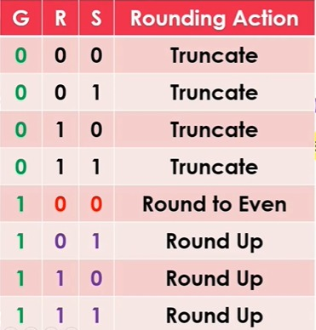
Rounding :

Slide 7
Test Plan
Not generating denormalized numbers.
Raise an exception flag when any special value like is generated.
Randomize 32-bit inputs individually to have better control over inputs.
Converting bits to shortreal and then multiply the numbers.
Converting shortreal results to bits using $shortrealtobits.
Comparing outputs of reference model and DUT output in bits.
Create the class that has random variables and constraints for not generating denormalized numbers and Nan’s.
To check whether denormalized numbers are generating.

Slide 8
System Verilog Constructs Used
Packages
Packed Structures
Enumerated types
Class
Constraint Randomization
Assertions
Task

Slide 9
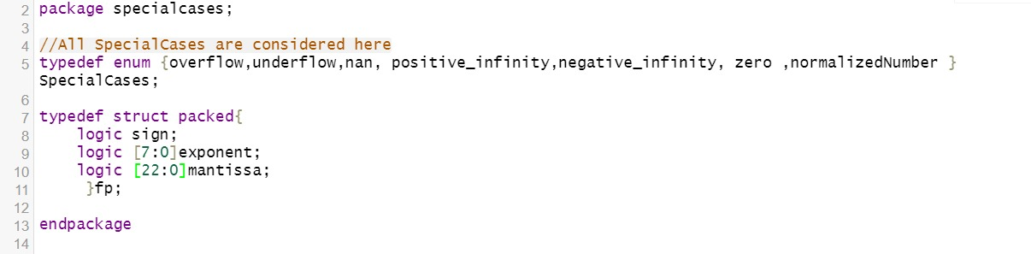
Packages

Slide 10

Packed Structures
Enumerated Types

Slide 11
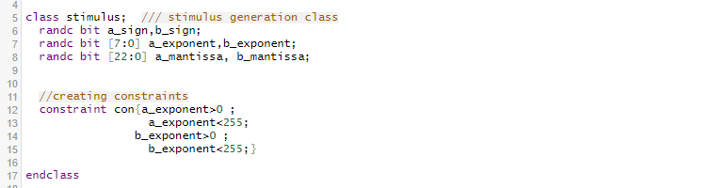
Class

Slide 12

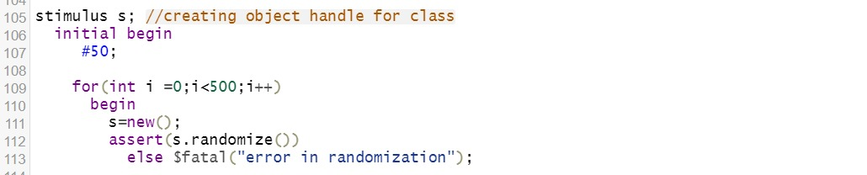
Constraint Randomization

Slide 13
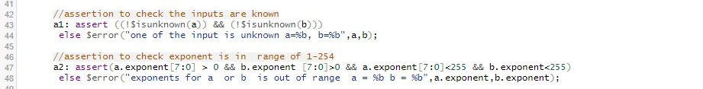
Assertions

Slide 14
Challenges Faced and Edification
Understanding the concepts of IEEE 754 format floating point numbers
Understanding the concept of rounding and normalization.
Implementation of system verilog constructs.

Slide 15
Future Scope
Can be extended upto 64 bit i.e., Double precision
Addition of Coverage

Slide 16
Source code :
https://github.com/nikhilreddi/SVFINAL

Slide 17
Reference
ECE 571 Lecture Slides
"Computer Organization and Design: The Hardware/Software Interface" by David A. Patterson and John L. Hennessy (edition 5). (Page ref from 197 to 209)
https://ieeexplore.ieee.org/document/8442343
https://youtu.be/rqz-CmNpWCM (nptel lectures)

